Slide 1
Numericals on Half and Full Adder
Dr. Manju Khurana
Assistant Professor, CSED
TIET, Patiala
manju.khurana@thapar.edu

Slide 2
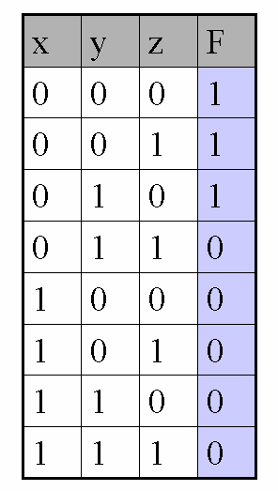
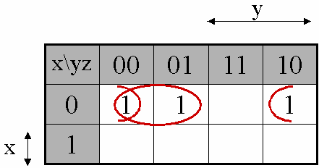
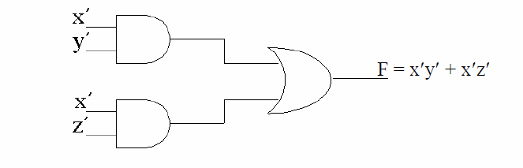
Q1: Design a combinational circuit with three inputs and one output. The output is 1 when the binary value of the inputs is less than 3. The output is 0 otherwise.

Slide 3
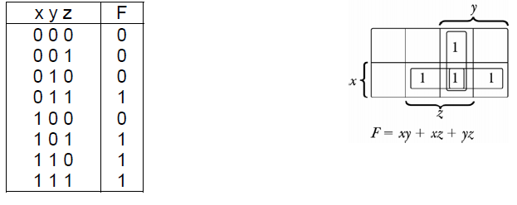
Q2: A majority function is generated in a combinational circuit when the output is equal to 1 if the input variables have more 1's than 0's. The output is 0 otherwise. Design a three-input majority function.

Slide 4
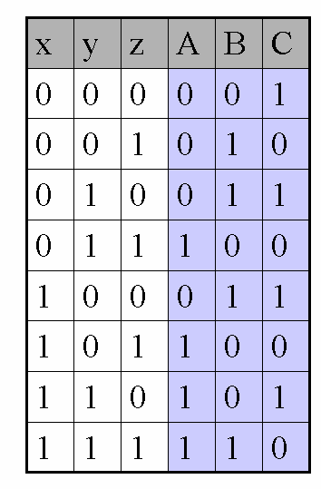
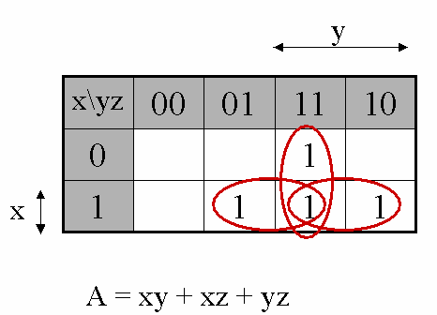
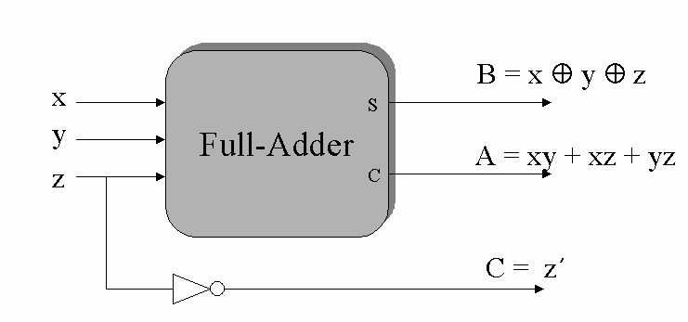
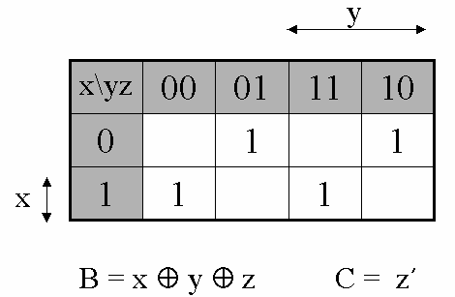
Q3: Design a combinational circuit with three inputs x, y, z and three outputs A, B, C. When the binary input is 0, 1, 2 , or 3, the binary output is one greater than the input. When the binary input is 4, 5 , 6, or 7, the binary output is one less than the input.

